Slide 2
Original Deliverable, 9/5/2018
Pump State | Predicted | Matching?
Full_Pump.csv | Full pump | Yes
Tubing_movement.csv | Tubing movement | Yes
Fluid_pound.csv | Fuid pound | Yes
Gas_interference.csv | Gas interference | Yes
The rest | Other | No

Slide 3
Second Deliverable, 9/10/2018
Pump State | Predicted | Matching?
Full_pump.csv | Full pump | Yes
Tubing_movement.csv | Tubing movement | Yes
Fluid_pound.csv | Fluid pound | Yes
Gas_interference.csv | Gas interference | Yes
Pump_hitting.csv | Pump hitting | Yes
Bent_barrel.csv | Worn or | No
Worn_plunger.csv | Worn plunger | Yes
Worn_standing.csv | Worn plunger | No
Worn_or.csv | Worn or | Yes
Fluid_friction.csv | Fluid friction | Yes
Drag_friction.csv | Drag friction | Yes
The rest | Other | No

Slide 4
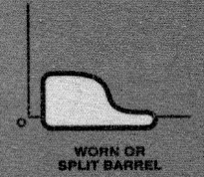
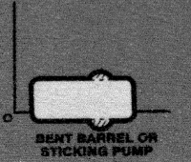
Potential Fixes to “bent barrel” prediction
Sympton: run “bent_barrel.csv” returns “Worn or” pump state
Expected: run “bent_barrel.csv” returns “Bent barrel”
Original Code | Potential Fixes
(shape.left->vertical() & shape.right->vertical() & (shape.bottom->length>0.8) & (shape.top->length>0.8)) Return “bent barrel” | shape.left->vertical() & shape.right->vertical() & (shape.bottom->length > 0.8) shape.bottom->second_half().flat()) Return “bent barrel”
Edge second_half() {
Edge ret("second half of " + name);
int index = n_points - 1;
for (int i = n_points - 1; i >= 0; i--) {
double x_diff_sqr = pow(xs[index] - xs[i], 2);
double y_diff_sqr = pow(ys[index] - ys[i], 2);
double dist_from_end = pow(x_diff_sqr + y_diff_sqr, 0.5);
if (dist_from_end <= 0.5 * length) {
ret.add_point(xs[i], ys[i]);}
else {
break;}
}
ret.finish();
return ret;}

Slide 5
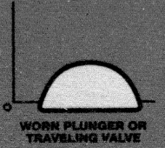
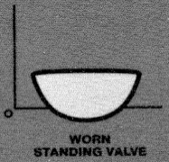
Potential Fixes to “worn standning” prediction
Sympton: run “worn_standing.csv” returns “worn plunger” pump state
Expected: run “worn_standing.csv” returns “worn standing” pump state
Original Code | Potential Fixes
// Worn plunger else if (shape.bottom->flat() & ~shape.left->vertical() & ~shape.right->vertical() & (shape.top->length < 0.9)) return "worn plunger"; // Worn standing else if (shape.top->flat() & ~shape.left->vertical() & ~shape.right->vertical() & (shape.bottom->length < 0.9)) return "worn standing"; | // Worn plunger else if (shape.bottom->flat() & ~shape.left->vertical() & ~shape.right->vertical() & (shape.top->length < 0.9) & (shape.top->length < shape.bottom->length)) return "worn plunger"; // Worn standing else if (shape.top->flat() & ~shape.left->vertical() & ~shape.right->vertical() & (shape.bottom->length < 0.9) & (shape.top->length > shape.bottom->length)) return "worn standing";

Slide 6
Potential Fixes to “worn or” prediction
Sympton: run “worn_standing.csv” returns “worn plunger” pump state
Expected: run “worn_standing.csv” returns “worn standing” pump state
Original Code | Potential Fixes
// Worn or // Worn or else if (shape.bottom->flat() & shape.top->flat() & shape.left->vertical() Return “worn or”; | // Worn or else if (shape.bottom->flat() & shape.top->flat() & shape.left->vertical() & shape.top->length < 0.8 & shape.right->inverse_fitted_line.r2 < 0.015) return "worn or";

Slide 7
Other Bug Fixes
Leading and trailing white spaces in sample data caused program to crash
Extra white space(s) in the middle of each row in the sample data caused program to crash
Leading white space in comments caused program to crash
Empty row or white space only row caused program to crash
Data normalization on Large dataset hangs the program
std::string trim(const std::string& str, const std::string& whitespace = " \t") { const auto strBegin = str.find_first_not_of(whitespace); if (strBegin == std::string::npos) return ""; // no content const auto strEnd = str.find_last_not_of(whitespace); const auto strRange = strEnd - strBegin + 1; return str.substr(strBegin, strRange);} | std::string reduce(const std::string& str, const std::string&& fill = "", const std::string& whitespace = " \t") { auto result = trim(str, whitespace); auto beginSpace = result.find_first_of(whitespace); while (beginSpace != std::string::npos) { const auto endSpace = result.find_first_not_of(whitespace, beginSpace); const auto range = endSpace - beginSpace; result.replace(beginSpace, range, fill); const auto newStart = beginSpace + fill.length(); beginSpace = result.find_first_of(whitespace, newStart);} return result;}
double min_value = *(std::min_element(std::cbegin(inVec), std::cend(inVec))); double max_value = *(std::max_element(std::cbegin(inVec), std::cend(inVec))); double diff = max_value - min_value; for (int i = 0; i < inVec.size(); i++) { outVec.push_back((inVec[i] - min_value) / diff);}

Slide 8
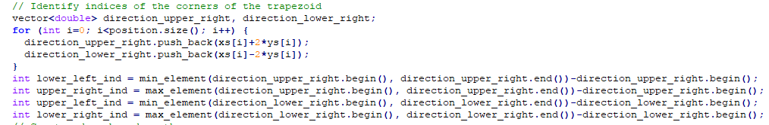
Question #1:
Please annotate the following code snippet or point to a online resource

Slide 9
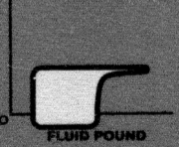
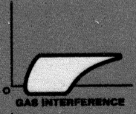
Question #2: “Fluid pound” vs “Gas interference?
// Fluid pound else if (shape.top->flat() & shape.bottom->flat() & shape.left->vertical() & (shape.bottom->length < 0.8) & (shape.right->normal_fitted_line.r2 > 0.015)) return "fluid pound"; | // Gas interference else if (shape.top->flat() & shape.left->vertical() & shape.bottom->flat() & (shape.bottom->length < 0.8)) return "gas interference";

Slide 10
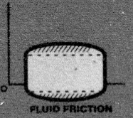
Question #3: Fluid Friction
Sympton: Not enough conditions for “fluid friction”, and consequently giving wrong pump state when the following
code snippet is moved above “full pump” code snippet.
Expected: It should still return “full pump” even the code snippet below, assuming fixed, is moved up when running
“full_pump.csv” file. Or provide more condition for the following code snippet.
// Fluid friction
else if (shape.right->vertical()
& shape.left->vertical())
return "fluid friction";

Slide 11
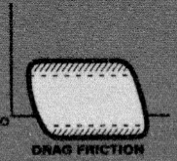
Question #3: Drag Friction
Sympton: Not enough conditions for “drag friction”, and consequently giving wrong pump state when the following
code snippet is moved above “full pump” code snippet.
Expected: It should still return “full pump” even the code snippet below, assuming fixed, is moved up when running
“full_pump.csv” file. Or provide more condition for the following code snippet.
// Drag friction
else if ((shape.right->length > 0.7)
& (shape.left->length > 0.7))
return "drag friction";

Slide 12
Question #4
Please annotate “if” statement conditions especially for those small floating points.

